Slide 1
Module II

Slide 2

Software Metrics
S. No | Topic
1. | LOC, Token Count, Function Count
2 | Design Metrics
3 | Data Structure Metrics
4 | Information Flow Metric
5 | Cost estimation, static, Single and multivariate models, COCOMO model,
6 | Putnam Resource Allocation Model
7 | Risk management

Slide 3
Software Metrics
Software Metrics: What and Why ?
How to measure the size of a software?
How much will it cost to develop a software?
How many bugs can we expect?
When can we stop testing?
When can we release the software?

Slide 4
Software Metrics
Software Metrics: What and Why ?
How to measure the size of a software?
How much will it cost to develop a software?
How many bugs can we expect?
When can we stop testing?
When can we release the software?

Slide 5
Software Metrics
What is the complexity of a module?
What is the module strength and coupling?
What is the reliability at the time of release?
Which test technique is more effective?
Are we testing hard or are we testing smart?
Do we have a strong program or a week test suite?

Slide 6
Software Metrics
Pressman explained as “A measure provides a quantitative indication of the extent, amount, dimension, capacity, or size of some attribute of the product or process”.
Measurement is the act of determine a measure
The metric is a quantitative measure of the degree to which
a system, component, or process possesses a given
attribute.
Fenton defined measurement as “ it is the process by which numbers or symbols are assigned to attributes of entities in the real world in such a way as to describe them according to clearly defined rules”.

Slide 7
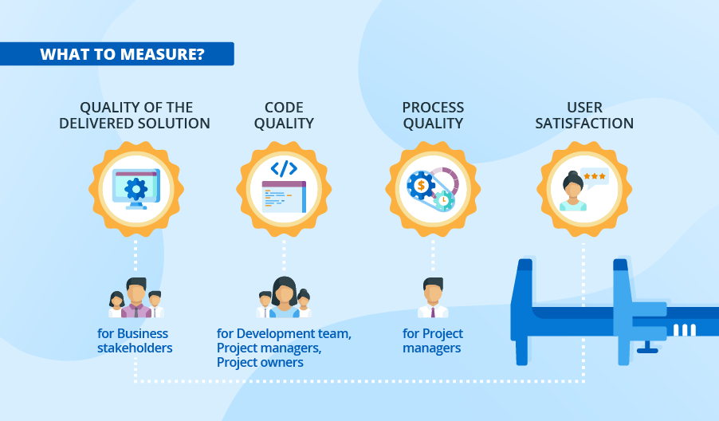
Software Metrics
Definition
Software metrics can be defined as “The continuous application of measurement based techniques to the software development process and its products to supply meaningful and timely management information, together with the use of those techniques to improve that process and its products”.

Slide 8
Software Metrics
Areas of Applications
The most established area of software metrics is cost and size estimation techniques.
The prediction of quality levels for software, often in terms of reliability, is another area where software metrics have an important role to play.
The use of software metrics to provide quantitative checks on software design is also a well established area.

Slide 9
Software Metrics
Problems During Implementation
Statement
: Software development is to complex; it cannot be managed like other parts of the organization.
Management view
: Forget
it, we will find
developers and manage that
managers who will development.
Statement
: I am only six months late with project.
Management view
: Fine, you are only out of a job.

Slide 10
Software Metrics
Statement
: I am only six months late with project.
Management view
: Fine, you are only out of a job.
Statement
: But you cannot put reliability constraints in the contract.
Management view
: Then we may not get the contract.

Slide 11
Software Metrics
Categories of Metrics
Product metrics: describe the characteristics of the product such as size, complexity, design features, performance, efficiency, reliability, portability, etc.
ii.
Process metrics: describe the
effectiveness and
quality of the processes that
produce the software
product. Examples are:
effort required in the process
time to produce the product
effectiveness of defect removal during development
number of defects found during testing
maturity of the process

Slide 12
Software Metrics
Project metrics: describe the project characteristics and execution. Examples are :
number of software developers
staffing pattern over the life cycle of the software
cost and schedule
productivity

Slide 13
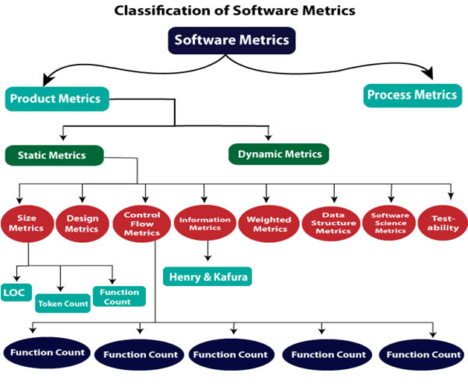
Software Metrics

Slide 14
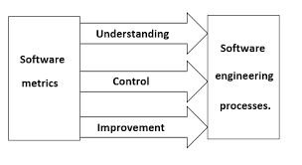
Software Metrics are helpful in software Project planning
14

Slide 15
Software Project Planning
After the finalization of SRS, we would estimate size, cost and development time
like to of the
project. Also, in many cases, customer may like to know the cost and development time even prior to finalization of the SRS.
15

Slide 16
Software Project Planning
In order to conduct a successful software project, we must understand:
Scope of work to be done
The risk to be incurred
The resources required
The task to be accomplished
The cost to be expended
The schedule to be followed
16

Slide 17
Software Project Planning
Software planning begins before technical work starts, continues as the software evolves from concept to reality, and culminates only when the software is retired.
Size estimation
Cost estimation
Development time
Resources requirements
Fig. 1: Activities during Software Project Planning
Project scheduling
17

Slide 18
Software Project Planning
Size metrics
Size Estimation
Lines of Code (LOC)
If LOC is simply a count of the number of lines then figure shown below contains 18 LOC .
When comments and blank lines are ignored, the program in figure 2 shown below contains 17 LOC.
Fig. 2: Function for sorting an array
1. | int. sort (int x[ ], int n)
2. | {
3. | int i, j, save, im1;
4. | /*This function sorts array x in ascending order */
5. | If (n<2) return 1;
6. | for (i=2; i<=n; i++)
7. | {
8. | im1=i-1;
9. | for (j=1; j<=im; j++)
10. | if (x[i] < x[j])
11. | {
12. | Save = x[i];
13. | x[i] = x[j];
14. | x[j] = save;
15. | }
16. | }
17. | return 0;
18. | }
18

Slide 19
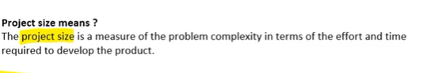
Software Project Planning
Size metrics

Slide 20

Software Project Planning
Size metrics
Advantages :
Most used metric in cost estimation.
Its alternates have many problems as compared to this metric.
It is very easy in estimating the efforts.

Slide 21
Software Project Planning
Size metrics
Disadvantages :
Increases productivity while writing more lines of code.
Less efficient code.
It doesn’t consider complexity.

Slide 22
Software Metrics
Example
void selSort(int x[], int n) {
//Below function sorts an array in ascending order
int i, j, min, temp;
for (i = 0; i < n - 1; i++) {
min = i;
for (j = i + 1; j < n; j++)
if (x[j] < x[min])
min = j;
temp = x[i];
x[i] = x[min];
x[min] = temp;
}
}
Lines of code are 12 // excluding the comments lines.

Slide 23
Software Project Planning
What is the lines of code for the following program????
void main()
{
int fN, sN, tN;
cout << "Enter the 2 integers: ";
cin >> fN >> sN;
// sum of two numbers in stored in variable sum
sum = fN + sN;
// Prints sum
cout << fN << " + " << sN << " = " << sum;
return 0;
}

Slide 24
Software Metrics
S. No | Topic
1. | LOC, Token Count, Function Count
2 | Design Metrics
3 | Data Structure Metrics
4 | Information Flow Metric
5 | Cost estimation, static, Single and multivariate models, COCOMO model,
6 | Putnam Resource Allocation Model
7 | Risk management

Slide 25
Halstead complexity measures
Halstead complexity measures are software metrics introduced by Maurice Howard Halstead in 1977
Halstead made the observation that metrics of the software should reflect the implementation or expression of algorithms in different languages
A computer program is an implementation of an algorithm considered to be a collection of tokens which can be classified as either operators or operands.
Halstead’s metrics are included in a number of current commercial tools that count software lines of code. By counting the tokens and determining which are operators and which are operands, the following base measures can be collected

Slide 26
Software Metrics
Size metrics
Token Count
The size of the vocabulary of a program, which consists of the number of unique tokens used to build a program is defined as:
η = η₁+ η₂
η : vocabulary of a program
η₁ : number of unique operators
η₂ : number of unique operands
where

Slide 27
Software Metrics
Size metrics
The length of the program in the terms of the total number of tokens used is
N = N₁+N₂
N : program length
N₁ : total occurrences of operators N₂ : total occurrences of operands
where

Slide 28
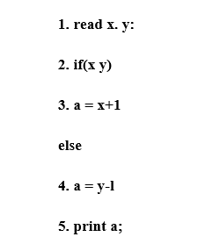
Software Metrics
Size metrics
Calculate the vocabulary of the program and Length of the program
S.N. | operators(n1) | occurrences(NI) | operands(n2) | occurrences(N2)
`1 | read | 1 | a | 2
2 | if | 1 | x | 2
3 | else | 1 | y | 2
4 | print | 1
5 | () | 1
6 | =
7 | + | 2
8 | - | 1
9 | ; | 1
10 | : | 1
 | Total n1=10 | Total(N1)=10 | Total n2=3 | Total(N2)=6

Slide 29
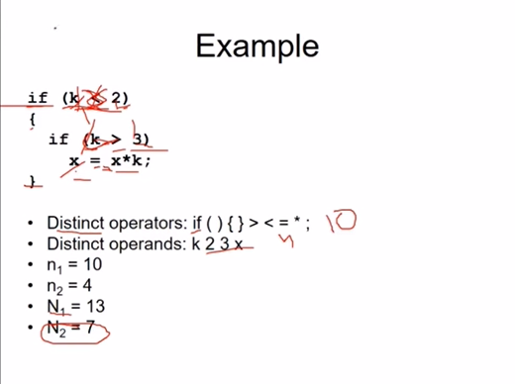
Software Metrics
Size metrics
Calculate the vocabulary of the program and Length of the program

Slide 30
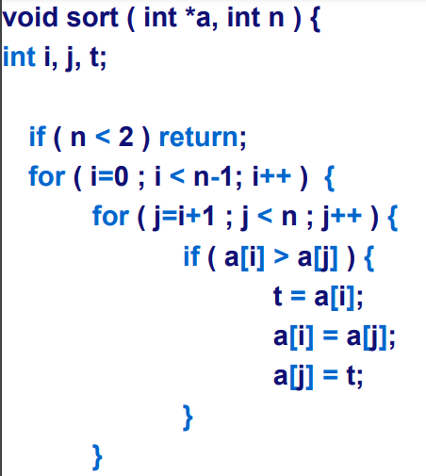

Software Metrics
Calculate the vocabulary of the program and Length of the program

Slide 31
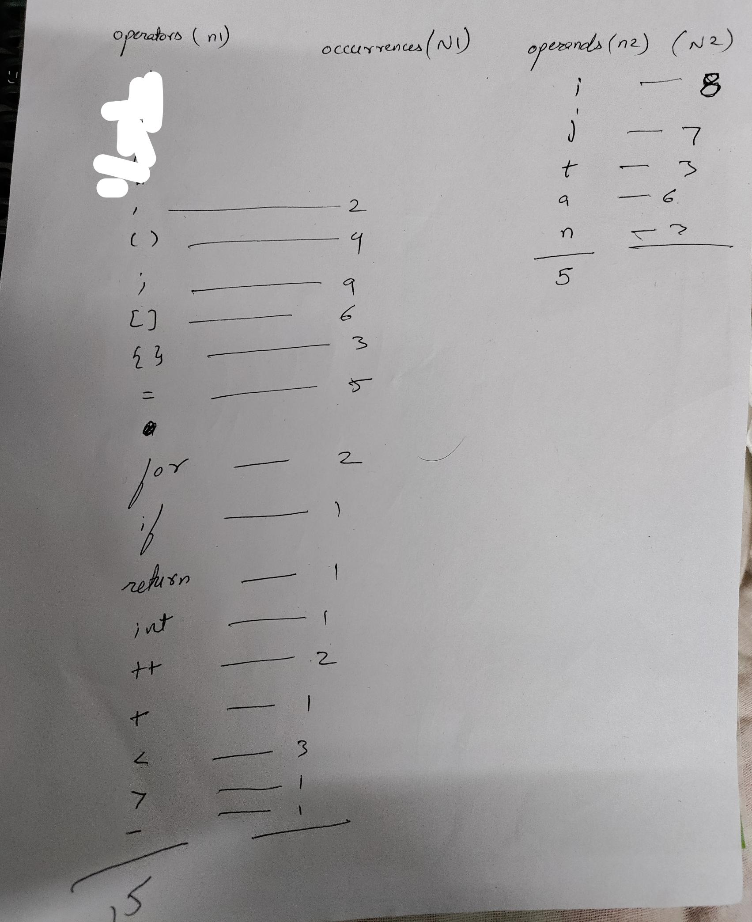
Software Metrics

Slide 32
Software Metrics
Size metrics
Volume
V = N * log₂ η
The unit of measurement of volume is the common unit for size “bits”. It is the actual size of a program if a uniform binary encoding for the vocabulary is used.
Potential Minimum Volume – The potential minimum volume V* is defined as the volume of the most succinct program in which a problem can be coded. V* = (2 + n2*) * log₂(2 + n2*)
Here, n2* is the count of unique input and output parameters

Slide 33
Software Metrics
Size metrics
Program Level
L = V* / V
The value of L ranges between zero and one, with L=1 representing a program written at the highest possible level (i.e., with minimum size).

Slide 34
Software Metrics
Size metrics
Program Difficulty
D = 1 / L
As the volume of an implementation of a program increases, the program level decreases and the difficulty increases. Thus, programming practices such as redundant usage of operands, or the failure to use higher-level control constructs will tend to increase the volume as well as the difficulty.
Effort
E = V / L = D * V
The unit of measurement of E is elementary mental discriminations.

Slide 35
Software Metrics
Size metrics
Estimated Program Length
∧
Ν = η₁ log ₂ η₁ + η ₂ log ₂ η ₂
∧
Ν = 14 log₂ 14 +10 log₂ 10
= 53.34 + 33.22 = 86.56
The following alternate expressions have been published to estimate program length.
Ν _{J} = Log₂ (η₁!) + log₂ (η₂!)

Slide 36
Software Metrics
Size metrics
Ν _{B} = η₁Log₂η₂ +η₂ log₂ η₁
Ν_{c} = η₁ η₁ +η₂ η₂
Ν _{s} = (η log₂ η) / 2
The definitions of unique operators, unique operands, total operators and total operands are not specifically delineated.

Slide 37
Software Metrics
Size metrics
Counting rules for C language
Comments are not considered.
The identifier and function declarations are not considered.
All the variables and constants are considered operands.
Global variables used in different modules of the same program are counted as multiple occurrences of the same variable.

Slide 38
Software Metrics
Local variables with the same name in different functions are counted as unique operands.
Functions calls are considered as operators.
All looping statements e.g., do {…} while ( ), while ( ) {…}, for ( )
{…}, all control statements e.g., if ( ) {…}, if ( ) {…} else {…}, etc. are considered as operators.
In control construct switch ( ) {case:…}, switch as well as all the case statements are considered as operators.

Slide 39
Software Metrics
Size metrics
The reserve words like return, default, continue, break, sizeof, etc., are considered as operators.
All the brackets, commas, and terminators are considered as operators.
GOTO is counted as an operator and the label is counted as an operand.
The unary and binary occurrence of “+” and “-” are dealt separately. Similarly “*” (multiplication operator) are dealt with separately.

Slide 40
Software Metrics
Size metrics
In the array variables such as “array-name [index]” “array- name” and “index” are considered as operands and [ ] is considered as operator.
In the structure variables such as “struct-name, member-name” or “struct-name -> member-name”, struct-name, member-name are taken as operands and ‘.’, ‘->’ are taken as operators. Some names of member elements in different structure variables are counted as unique operands.
All the hash directive are ignored.

Slide 41
Software Metrics
Size metrics
Halstead offered an alternate formula that estimate the program level.
∧
L = 2η₂ /(η₁Ν₂ )
where
∧
∧
D =
1 η₁Ν₂
=
2η
∧
L
2

Slide 42
Software Metrics
Size metrics
Effort and Time
∧ ∧
Ε = V / L = V * D
= (n₁ N₂ N log₂ η) / 2η₂
T = E / β
β is normally set to 18 since this seemed to give best results in
Halstead’s earliest experiments, which compared times with observed programming times, including design, coding, and testing.
the predicted the time for

Slide 43
Software Metrics
Size metrics
Language Level
λ = L ×V * = L²V
Using this formula, Halstead and other researchers determined the language level for various languages as shown in Table 1.

Slide 44
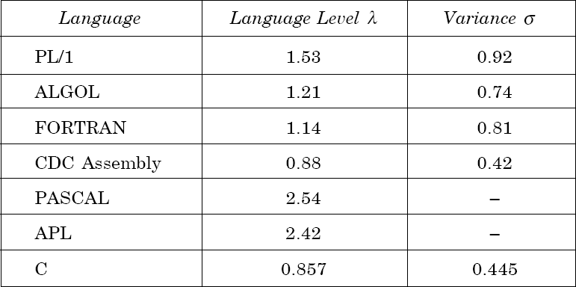
Software Metrics
Size metrics
Table 1: Language levels

Slide 45
Software Metrics
Size metrics
Example- 6.I
Consider the sorting program in Fig. 2 of chapter 4. List out the
operators and operands and also calculate the values of software science measures like η, N ,V , E, λ etc.

Slide 46
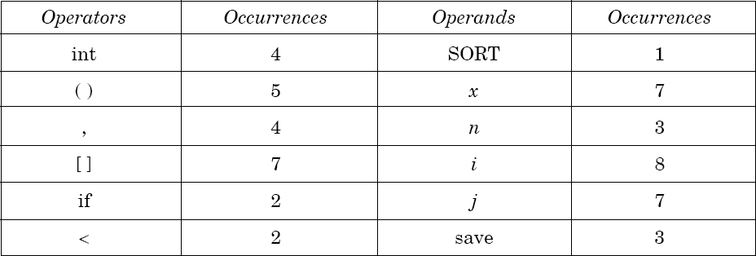
Software Metrics
Size metrics
Solution
The list of operators and operands is given in table 2.

Slide 47
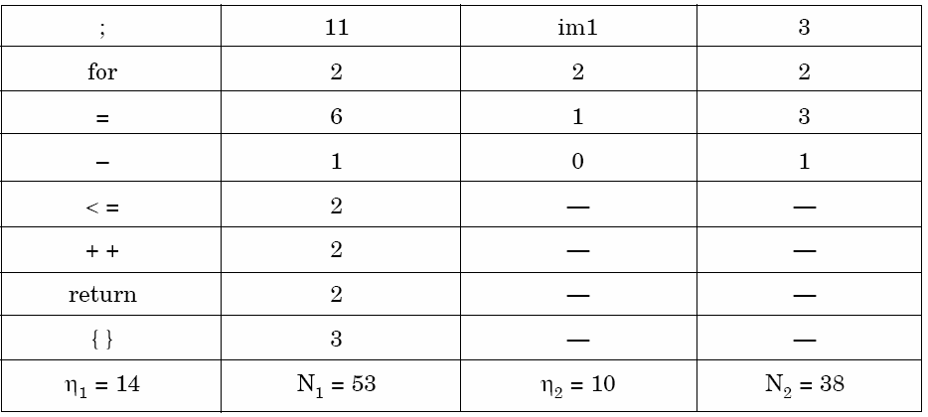
Software Metrics
Size metrics
Table 2: Operators and operands of sorting program of fig. 2 of chapter 4

Slide 48
Software Metrics
Size metrics
Here N₁=53 and N₂=38. The program length N=N₁+N₂=91
Vocabulary of the program η = η₁ +η₂ = 14 +10 = 24
V = N ×log₂ η
= 91 x log₂24 = 417 bits
∧
The estimated program length _{N} of the program
= 14 log₂14 + 10 log₂10
= 14 * 3.81 + 10 * 3.32
Volume
= 53.34 + 33.2 = 86.45

Slide 49
Software Metrics
Size metrics
Conceptually unique
input and output parameters are
represented by η*
2
η* = 3
{x: array holding the integer to be sorted. This is used both as input and output}.
{N: the size of the array to be sorted}.
2
The potential volume V* = 5 log₂5 = 11.6
Since L = V* / V

Slide 50
Software Metrics
Size metrics
= ^{11.6} = 0.027
417
D = I / L
1
=
= 37.03
0.027
Estimated program level
∧
L = ×
2 η₂ 2 10
= × = 0.038
η₁ N₂
14 38

Slide 51
Software Metrics
Size metrics
We may use another formula
∧ ∧
V = V × L = 417 × 0.038 = 15.67
∧ ∧ ∧
E = V / L = D×V
=417 / 0.038 = 10973.68
Therefore, 10974
elementary mental discrimination are
required to construct the program.
T = E / β = ¹⁰⁹⁷⁴ = 610 seconds = 10 minutes
18
This is probably a reasonable time to produce the program, which is very simple

Slide 52
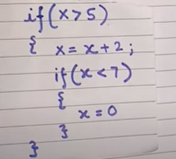
Software Metrics
Size metrics
Calculate the Halstead Metrics for this piece of code.

Slide 53
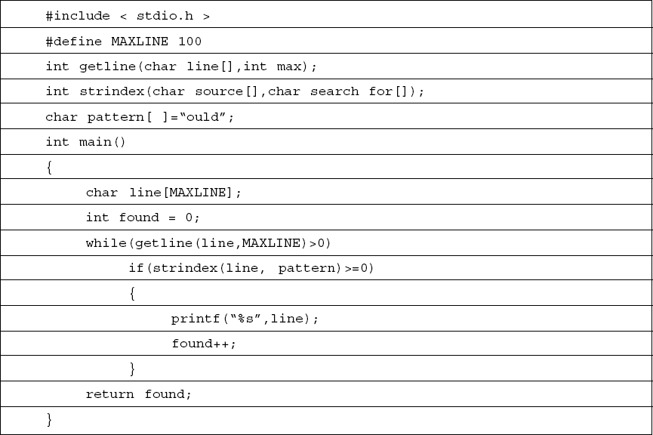
Software Metrics
Size metrics
Table 3
Software Engineering

Slide 54
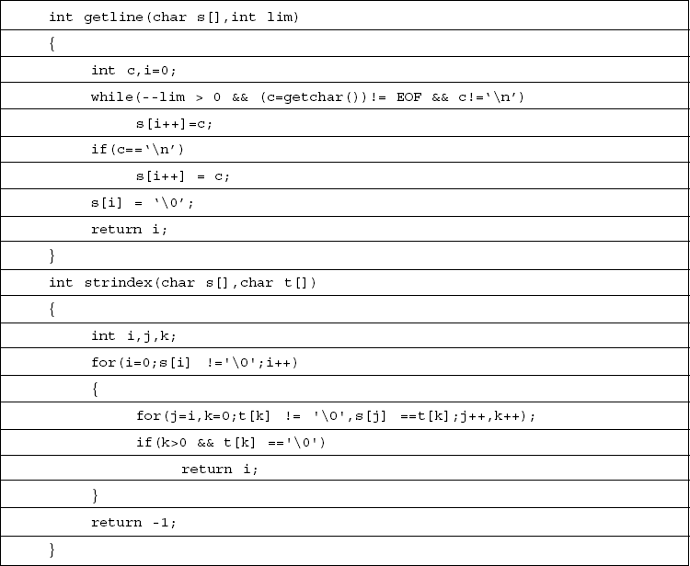
Software Metrics
Size metrics
Table 3
Software Engineering

Slide 55
Software Metrics
Size metrics
Example- 6.2
Consider the program shown software science metrics.
in Table 3. Calculate the various

Slide 56
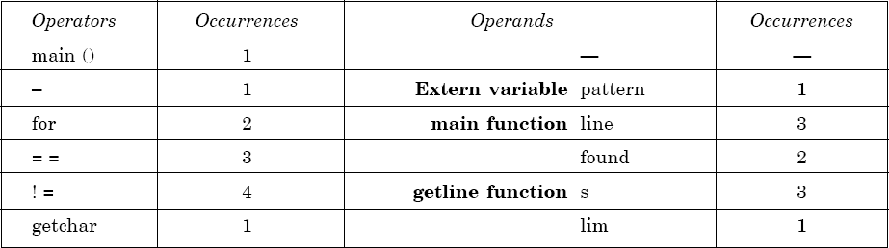
Software Metrics
Size metrics
Solution
List of operators and operands are given in Table 4.
Table 4

Slide 57
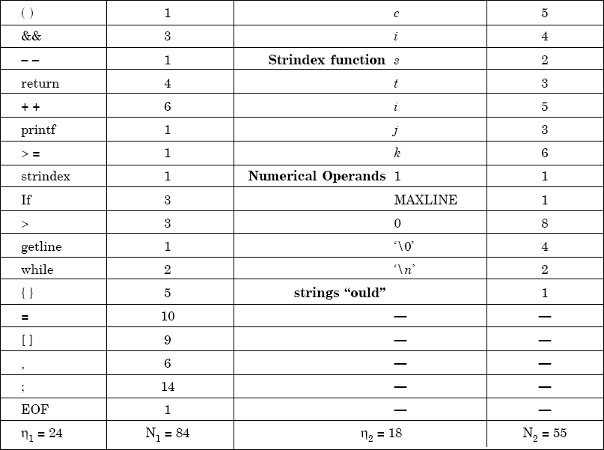
Software Metrics
Size metrics
Table 5

Slide 58
Software Metrics
Size metrics
Program vocabulary η = 42
N = N₁ +N₂
= 84 + 55 = 139
∧
N = 24 log₂ 24 +18 log₂ 18 = 185.115
= 24.91
V = 749.605 bits
Program length
Estimated length
% error
Program volume
₌ 2 × η₂
Estimated program level
η₁ N₂
= ² × ¹⁸ = 0.02727
24 55

Slide 59
Software Metrics
Size metrics
Minimal volume
V*=20.4417
∧
= V / L
₌ 748.605
Effort
.02727
= 27488.33 elementary mental discriminations.
27488.33
Time T =
E / β =
18
= 1527.1295 seconds
= 25.452 minutes

Slide 60
Software Metrics
S. No | Topic
1. | LOC, Token Count, Function Count
2 | Design Metrics
3 | Data Structure Metrics
4 | Information Flow Metric
5 | Cost estimation, static, Single and multivariate models, COCOMO model,
6 | Putnam Resource Allocation Model
7 | Risk management

Slide 61
Software Project Planning
Software Metrics
Function Count
Alan Albrecht while working for IBM, recognized the problem in size measurement in the 1970s, and developed a technique (which he called Function Point Analysis), which appeared to be a solution to the size measurement problem.
Size metrics
61

Slide 62
Software Project Planning
Size metrics
Software Metrics
The principle of Albrecht’s function point analysis (FPA) is that a system is decomposed into functional units.
Inputs
Outputs
Enquiries
:
:
:
information entering the system information leaving the system
requests for instant access to information
information held within the system
information held by other system that is used by the system being analyzed.
Internal logical files
:
External interface files
:
62

Slide 63
Software Project Planning
Size metrics
Software Metrics
The FPA functional units are shown in figure given below:
User
Inquiries
Other
applications
Inputs
ILF
User
EIF
Outputs
ILF: Internal logical files EIF: External interfaces
System
Fig. 3: FPAs functional units System
63

Slide 64
Software Project Planning
Size metrics
Software Metrics
The five functional units are divided in two categories:
(i) Data function types
Internal Logical Files (ILF): A user identifiable group of logical related data or control information maintained within the system.
External Interface files (EIF): A user identifiable group of logically related data or control information referenced by the system, but maintained within another system. This means that EIF counted for one system, may be an ILF in another system.
64

Slide 65
Software Project Planning
Size metrics
Software Metrics
Transactional function types
External Input (EI): An EI processes data or control information that comes from outside the system. The EI is an elementary process, which is the smallest unit of activity that is meaningful to the end user in the business.
External Output (EO): An EO is an elementary process that generate data or control information to be sent outside the system.
External Inquiry (EQ): An EQ is an elementary process that is made up to an input-output combination that results in data retrieval.
65

Slide 66
Software Project Planning
Software Metrics
Special features
Function point approach is independent of the language, tools, or methodologies used for implementation; i.e. they do not take into consideration programming languages, data base management systems, processing hardware or any other data base technology.
Function points can be estimated from requirement specification or design specification, thus making it possible to estimate development efforts in early phases of development.
66

Slide 67
Software Project Planning
Size metrics
Software Metrics
Function points are directly linked to the statement of requirements; any change of requirements can easily be followed by a re-estimate.
Function points are based on the system user’s external view of the system, non-technical users of the software system have a better understanding of what function points are measuring.
67

Slide 68
Software Project Planning
Counting function points
Functional Units | Weighting factors
 | Low | Average | High
External Inputs (EI) | 3 | 4 | 6
External Output (EO) | 4 | 5 | 7
External Inquiries (EQ) | 3 | 4 | 6
External logical files (ILF) | 7 | 10 | 15
External Interface files (EIF) | 5 | 7 | 10
Table 1 : Functional units with weighting factors
68

Slide 69
Software Project Planning
Size metrics
Software Metrics
Table 2: UFP calculation table
Functional Units |  | Count Complexity |  |  | Complexity Totals |  |  | Functional Unit Totals
External Inputs (EIs) |  | Low x 3 Average x 4 |  | = =
 |  |  | High x 6 | =
External Outputs (EOs) |  | Low x 4 Average x 5 |  | = =
 |  |  | High x 7 | =
External Inquiries (EQs) |  | Low x 3 Average x 4 |  | = =
 |  |  | High x 6 | =
External logical Files (ILFs) |  | Low x 7 Average x 10 High x 15 |  | = = =
External Interface Files (EIFs) |  | Low x 5 Average x 7 |  | = =
 |  |  | High x 10 | =
Total Unadjusted Function Point Count
69

Slide 70
Software Project Planning
Software Metrics
The weighting factors are identified for all functional units and multiplied with the functional units accordingly. The procedure for the calculation of Unadjusted Function Point (UFP) is given in table shown above.
70

Slide 71
Software Project Planning
Size metrics
Software Metrics
The procedure for the calculation of UFP in mathematical form is given below:
5 3
UFP = ∑∑ Z_{ij} w_{ij}
i=1 J =1
Where i indicate the row and j indicates the column of Table 1
W_{ij} : It is the entry of the i^{th} row and j^{th} column of the table 1
Zij : It is the count of the number of functional units of Type i that have been classified as having the complexity corresponding to column j.
71

Slide 72
Software Project Planning
Software Metrics
Organizations that use function point methods develop a criterion for determining whether a particular entry is Low, Average or High. Nonetheless, the determination of complexity is somewhat subjective.
FP = UFP * CAF
Where CAF is complexity adjustment factor and is equal to [0.65 +
0.01 x ΣF_{i}]. The F_{i} (i=1 to 14) are the degree of influence and are based on responses to questions noted in table 3.
72

Slide 73
Software Project Planning
Size metrics
Software Metrics
Table 3 : Computing function points.
Rate each factor on a scale of 0 to 5.
0 1 2 3
4
5
No Influence
Average
Essential
Incidental Moderate Significant
Number of factors considered ( F_{i} )
Does the system require reliable backup and recovery ?
Is data communication required ?
Are there distributed processing functions ?
Is performance critical ?
Will the system run in an existing heavily utilized operational environment ?
Does the system require on line data entry ?
Does the on line data entry require the input transaction to be built over multiple screens or operations ?
Are the master files updated on line ?
Is the inputs, outputs, files, or inquiries complex ?
Is the internal processing complex ?
Is the code designed to be reusable ?
Are conversion and installation included in the design ?
Is the system designed for multiple installations in different organizations ?
Is the application designed to facilitate change and ease of use by the user ?
73

Slide 74
Software Project Planning
Size metrics
Software Metrics
Functions points may compute the following important metrics:
Productivity Quality | = = | FP / persons-months Defects / FP
Cost | = | Rupees / FP
Documentation | = | Pages of documentation per FP
These metrics are controversial and are not universally acceptable. There are standards issued by the International Functions Point User Group (IFPUG, covering the Albrecht method) and the United Kingdom Function Point User Group (UFPGU, covering the MK11 method). An ISO standard for function point method is also being developed.
74

Slide 75
Software Project Planning
Size metrics
Software Metrics
Example: 4.1
Consider a project with the following functional units:
Number of user inputs Number of user outputs Number of user enquiries Number of user files
Number of external interfaces
= 50
= 40
= 35
= 06
= 04
Assume all complexity adjustment factors and weighting factors are average. Compute the function points for the project.
75

Slide 76
Software Project Planning
Software Metrics
Solution
We know
5 3
UFP = ∑∑ Z_{ij} w_{ij}
i=1 J =1
UFP = 50 x 4 + 40 x 5 + 35 x 4 + 6 x 10 + 4 x 7
= 200 + 200 + 140 + 60 + 28 = 628
CAF = (0.65 + 0.01 ΣF_{i})
= (0.65 + 0.01 (14 x 3)) = 0.65 + 0.42 = 1.07 FP = UFP x CAF
= 628 x 1.07 = 672
76

Slide 77
Software Project Planning
Size metrics
Software Metrics
Example:4.2
An application has the following:
10 low external inputs, 12 high external outputs, 20 low
internal logical files, 15 high external interface files, 12 average external inquiries, and a value of complexity
adjustment factor of 1.10.
What are the unadjusted and adjusted function point counts ?
77

Slide 78
Software Project Planning
Size metrics
Solution
Unadjusted function point counts may be calculated using as:
5 3
UFP = ∑∑ Z_{ij} w_{ij}
i=1 J =1
= 10 x 3 + 12 x 7 + 20 x 7 + 15 + 10 + 12 x 4
= 30 + 84 +140 + 150 + 48
= 452
FP
= UFP x CAF
= 452 x 1.10 = 497.2.
78

Slide 79
Software Project Planning
Size metrics
Example: 4.3
Consider a project with the following parameters.
External Inputs:
10 with low complexity (b)15 with average complexity
(c) 17 with high complexity
External Outputs:
6 with low complexity (b)13 with high complexity
External Inquiries:
3 with low complexity
4 with average complexity
2 high complexity
79

Slide 80
Software Project Planning
Internal logical files:
2 with average complexity (b)1 with high complexity
External Interface files:
9 with low complexity
In addition to above, system requires
Significant data communication
Performance is very critical
Designed code may be moderately reusable
System is not designed for multiple installation in different organizations.
Other complexity adjustment factors are treated as average. Compute the function points for the project.
80

Slide 81
Software Project Planning
Size metrics
Solution: Unadjusted function points may be counted using table 2
Functional Units | Count | Complexity |  | Complexity Totals |  |  | Functional Unit Totals
External Inputs | 10 15 | Low x 3 Average x 4 | = = |  | 30 60
(EIs) | 17 | High x 6 | = |  | 102 | 192
External Outputs (EOs) | 6 0 13 | Low x 4 Average x 5 High x 7 | = = = |  | 24 0 91 | 115
External Inquiries (EQs) | 3 4 2 | Low x 3 Average x 4 High x 6 | = = = |  | 9 16 12 | 37
External logical | 0 2 | Low x 7 Average x 10 | = = |  | 0 20
Files (ILFs) | 1 | High x 15 | = |  | 15 | 35
External | 9 | Low x 5 Average x 7 High x 10 | = = = |  | 45
Interface | 0 |  |  |  | 0
Files (EIFs) | 0 |  |  |  | 0 | 45
 | Total Unadjusted Function Point Count |  |  |  |  |  | 424
81

Slide 82
Software Project Planning
Software Metrics
14
∑ ^{F}i
= 3+4+3+5+3+3+3+3+3+3+2+3+0+3=41
i=1
CAF = (0.65 + 0.01 x ΣF_{i})
= (0.65 + 0.01 x 41)
= 1.06
FP = UFP x CAF
= 424 x 1.06
= 449.44
Hence FP = 449
82

Slide 83
Software Project Planning
Size metrics
Software Metrics
Solve own your own
Consider a project with the following functional units:
Number of user inputs Number of user outputs Number of user enquiries Number of user files
Number of external interfaces
=20
= 40
= 25
= 08
= 06
Assume all complexity adjustment factors and weighting factors are average. Compute the function points for the project.
83

Slide 84
Software Project Planning
Size metrics
Example: 4.3
Consider a project with the following parameters.
External Inputs:
10 with low complexity (b)15 with average complexity
(c) 17 with high complexity
External Outputs:
6 with low complexity (b)13 with high complexity
External Inquiries:
3 with low complexity
4 with average complexity
2 high complexity
84

Slide 85
Software Project Planning
Internal logical files:
3 with average complexity (b)12with high complexity
External Interface files:
10 with low complexity
In addition to above, system requires
Significant data communication
Performance is very critical
Designed code may be moderately reusable
System is not designed for multiple installation in different organizations.
Other complexity adjustment factors are treated as average. Compute the function points for the project.
85

Slide 86
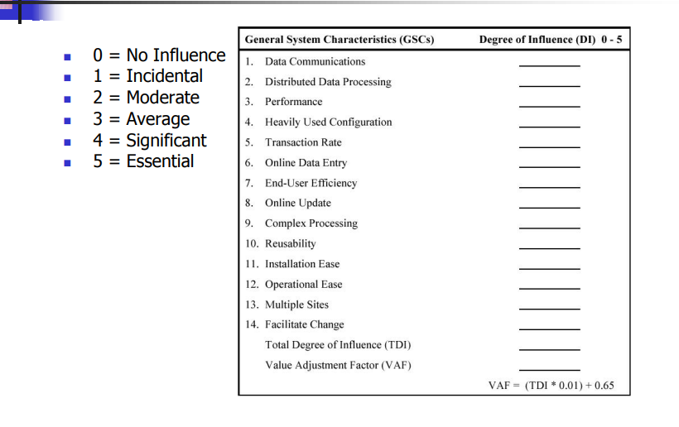
Software Project Planning
86

Slide 87
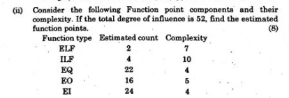
Software Project Planning
87

Slide 88
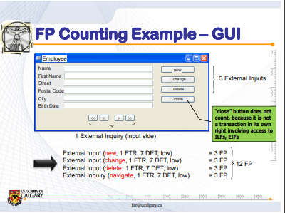
Software Project Planning
88

Slide 89
Software Metrics
S. No | Topic
1. | LOC, Token Count, Function Count
2 | Design Metrics
3 | Data Structure Metrics
4 | Information Flow Metric
5 | Cost estimation, static, Single and multivariate models, COCOMO model,
6 | Putnam Resource Allocation Model
7 | Risk management

Slide 90
Software Metrics
Data Structure Metrics
Program | Data Input | Internal Data | Data Output
Payroll | Name/ Social Security No./ Pay Rate/ Number of hours worked | Withholding rates Overtime factors Insurance premium Rates | Gross pay withholding Net pay Pay ledgers
Spreadsheet | Item Names/ Item amounts/ Relationships among items | Cell computations Sub-totals | Spreadsheet of items and totals
Software Planner | Program size/ No. of software developers on team | Model parameters Constants Coefficients | Est. project effort Est. project duration
Fig.1: Some examples of input, internal, and output data

Slide 91
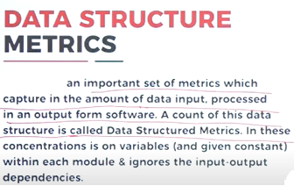
Software Metrics

Slide 92
Software Metrics
The Amount of Data
One method for determining the amount of data is to count the number of entries in the cross-reference list.
A variable is a string of alphanumeric characters that is defined by a developer and that is used to represent some value during either compilation or execution.

Slide 93
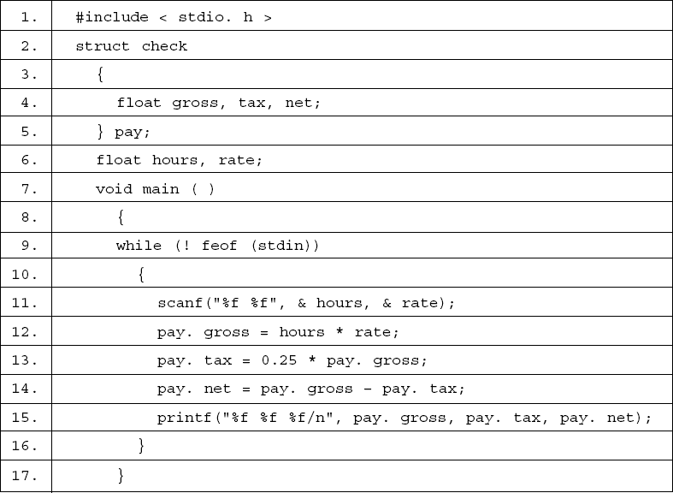
Software Metrics
Fig.2: Payday program

Slide 94
Software Metrics
check | 2
gross | 4 | 12 | 13 | 14 | 15
hours | 6 | 11 | 12
net | 4 | 14 | 15
pay | 5 | 12 | 13 | 13 | 14
 | 14 | 14 | 15 | 15 | 15
rate | 6 | 11 | 12
tax | 4 | 13 | 14 | 15
Fig.3: A cross reference of program payday

Slide 95
Software Metrics
feof | 9
stdin | 10
Fig.4: Some items not counted as VARS
η₂
= VARS + unique constants + labels.
Halstead introduced a metric that he referred to as _{η}
to be a count
2
of the operands in a program – including all variables, constants, and labels. Thus,
η₂ = VARS + uniqueconstants + labels

Slide 96

Software Metrics
Calculate the amount of data
#include <stdio.h>
int main()
{
int sum=0;
for(int i = 0; i<=10; i++)
{
sum = sum+i;
if(i==5)
{ goto addition;
}
}
addition:
printf("%d", sum); return 0;
}
η₂ = VARS + uniqueconstants + labels
constants
constants
Label

Slide 97
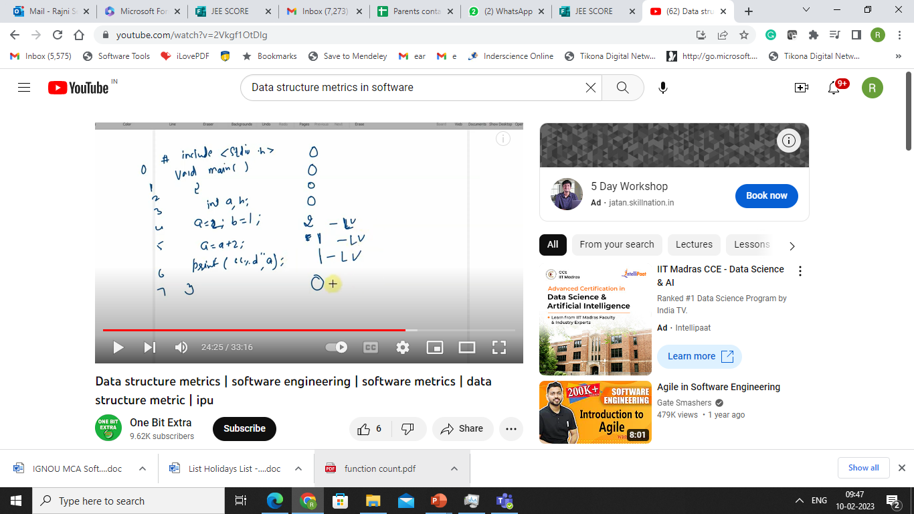
Software Metrics

Slide 98
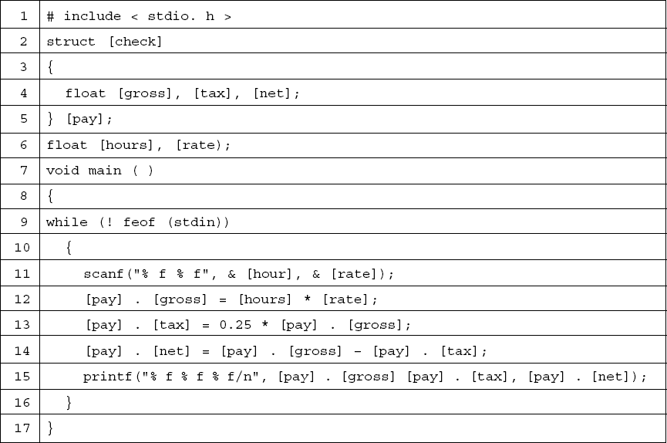
Software Metrics
Fig.6: Program payday with operands in brackets

Slide 99
Software Metrics
The Usage of Data within a Module
Live Variables Definitions :
A variable is live from the beginning of a procedure to the end of the procedure.
A variable is live at a particular statement only if it is referenced a certain number of statements before or after that statement.
A variable is live from its first to its last references within a procedure.

Slide 100
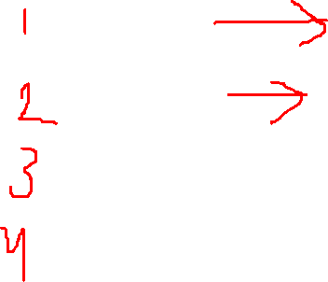
Software Metrics
The Usage of Data within a Module
Live Variables
{
int a, int b;
a =5, b=10;
Printf(“…….”);
a =a+10;
}
Declaration of variable
Variable a, b is live here
Variable a is live from line number 2 to 4, whereas b is live at line number 1

Slide 101
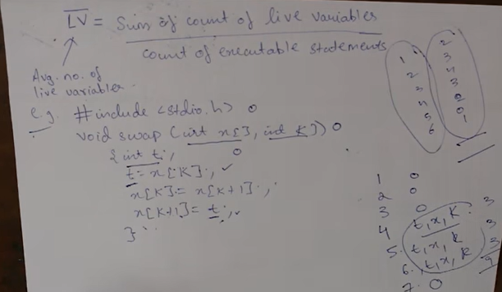
Software Metrics
cont…46

Slide 102
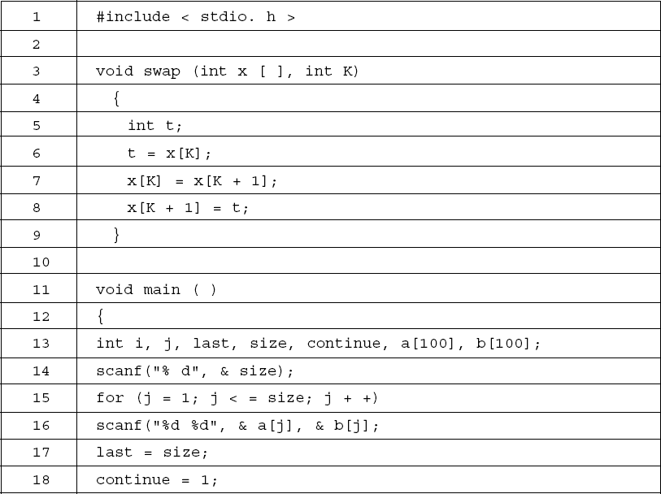
Software Metrics
cont…46
Software Engineering

Slide 103
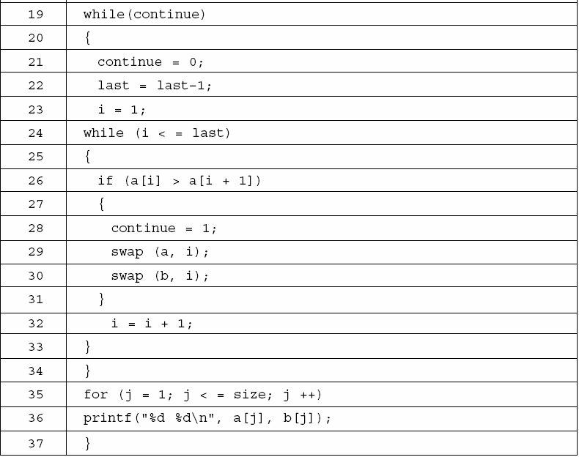
Software Metrics
Fig.6: Bubble sort program

Slide 104
Software Metrics
It is thus possible to define the average number of live variables,
(LV ) which is the sum of the count of live variables divided by the count of executable statements in a procedure. This is a complexity measure for data usage in a procedure or program. The live variables in the program in fig. 6 appear in fig. 7 the average live variables for this program is
¹²⁴ = 3.647
34

Slide 105
Software Metrics
Line | Live Variables | Count
4 | ---- | 0
5 | ---- | 0
6 | t, x, k | 3
7 | t, x, k | 3
8 | t, x, k | 3
9 | ---- | 0
10 | ---- | 0
11 | ---- | 0
12 | ---- | 0
13 | ---- | 0
14 | size | 1
15 | size, j | 2
16 | Size, j, a, b | 4
cont…

Slide 106
Software Metrics
Line | Live Variables | Count
17 | size, j, a, b, last | 5
18 | size, j, a, b, last, continue | 6
19 | size, j, a, b, last, continue | 6
20 | size, j, a, b, last, continue | 6
21 | size, j, a, b, last, continue | 6
22 | size, j, a, b, last, continue | 6
23 | size, j, a, b, last, continue, i | 7
24 | size, j, a, b, last, continue, i | 7
25 | size, j, a, b, continue, i | 6
26 | size, j, a, b, continue, i | 6
27 | size, j, a, b, continue, i | 6
28 | size, j, a, b, continue, i | 6
29 | size, j, a, b, i | 5
cont…

Slide 107
Software Metrics
Line | Live Variables | Count
30 | size, j, a, b, i | 5
31 | size, j, a, b, i | 5
32 | size, j, a, b, i | 5
33 | size, j, a, b | 4
34 | size, j, a, b | 4
35 | size, j, a, b | 4
36 | j, a, b | 3
37 | -- | 0
Fig.7: Live variables for the program in fig.6

Slide 108
Software Metrics
Variable spans
… 21
… 32
… 45
… 53
…
60
…
scanf (“%d %d, &a, &b)
x =a;
y = a – b; z = a;
printf (“%d %d, a, b);
Fig.: Statements in ac program referring to variables a and b.
The size of a span indicates the number of statements that pass between successive uses of a variables

Slide 109
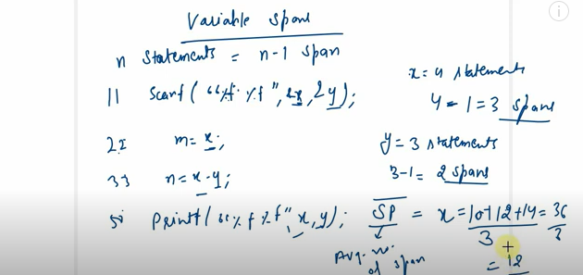
Software Metrics

Slide 110
Software Metrics
Making program-wide metrics from intra-module metrics
For example if we want to characterize the average number of live variables for a program having modules, we can use this equation.
m
Σ LV_{i}
LV program = ^{i=1}
m
is the average live variable metric computed from the ith module
where
(LV )_{i}
The average span size (SP) for a program of n spans could be computed by using the equation.
n
Σ SP_{i} SPprogram = ^{i=1}
n

Slide 111
Software Metrics
Program Weakness
A program consists of modules. Using the average number of live
variables (LV )
and average life variables (γ ), the module weakness
has been defined as
WM = LV *γ

Slide 112
Software Metrics
A program is normally a combination of various modules, hence program weakness can be a useful measure and is defined as:
 m

 Σ WM_{i} 
_{WP = } i=1

m
where, | WM_{i} | : weakness of ith module
 | WP m | : weakness of the program : number of modules in the program

Slide 113
Software Metrics
Example- 6.3
Consider a program for sorting and searching. The program sorts an array using selection sort and than search for an element in the
sorted array. The program is given in fig. 8. Generate cross
reference list for the program and also calculateLVan,dγW, M for the program.

Slide 114
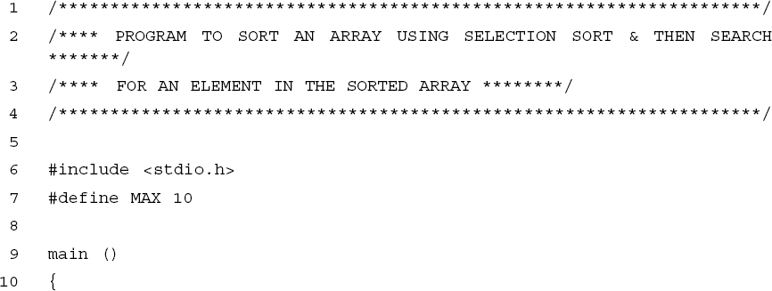
Software Metrics
Solution
The given program is of 66 lines and has 11 variables. The variables are a, I, j, item, min, temp, low, high, mid, loc and option.

Slide 115
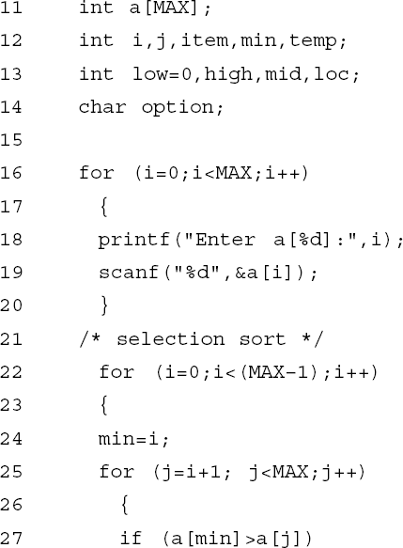
Software Metrics

Slide 116
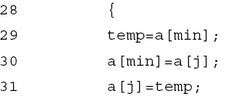
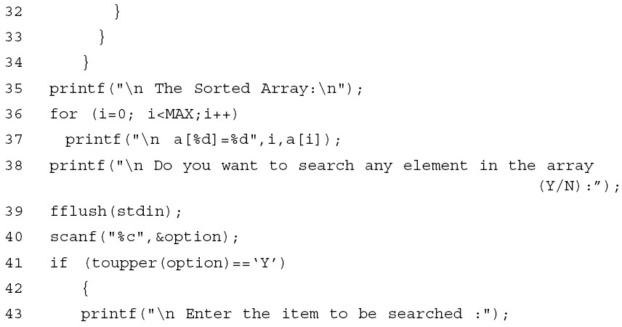
Software Metrics

Slide 117
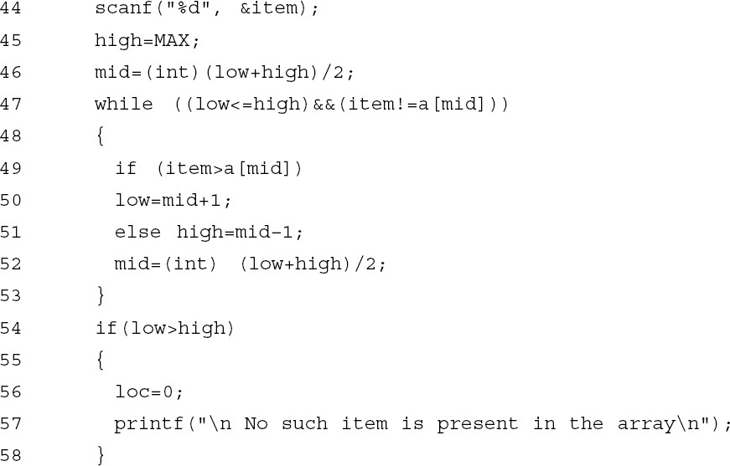
Software Metrics

Slide 118
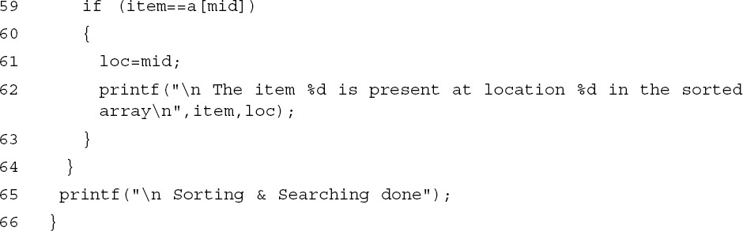
Software Metrics
Fig.8: Sorting & searching program

Slide 119
Software Metrics
Cross-Reference list of the program is given below:
a | 11 | 18 | 19 | 27 | 27 | 29 | 30 | 30 | 31 | 37 | 47 | 49 | 59
i | 12 | 16 | 16 | 16 | 18 | 19 | 22 | 22 | 22 | 24 | 36 | 36 | 36 | 37 | 37
j | 12 | 25 | 25 | 25 | 27 | 30 | 31
item | 12 | 44 | 47 | 49 | 59 | 62
min | 12 | 24 | 27 | 29 | 30
temp | 12 | 29 | 31
low | 13 | 46 | 47 | 50 | 52 | 54
high | 13 | 45 | 46 | 47 | 51 | 52 | 54
mid | 13 | 46 | 47 | 49 | 50 | 51 | 52 | 59 | 61
loc | 13 | 56 | 61 | 62
option | 14 | 40 | 41

Slide 120

Live Variables per line are calculated as:
Line | Live Variables | Count
13 | low | 1
14 | low | 1
15 | low | 1
16 | low, i | 2
17 | low, i | 2
18 | low, i, a | 3
19 | low, i, a | 3
20 | low, i, a | 3
22 | low, i, a | 3
23 | low, i, a | 3
24 | low, i, a, min | 4
25 | low, i, a, min, j | 5
26 | low, i, a, min, j | 5
cont…₁₂₀

Slide 121
Software Metrics
Line | Live Variables | Count
27 | low, i, a, min, j | 5
28 | low, i, a, min, j | 5
29 | low, i, a, min, j, temp | 6
30 | low, i, a, min, j, temp | 6
31 | low, i, a, j, temp | 5
32 | low, i, a | 3
33 | low, i, a | 3
34 | low, i, a | 3
35 | low, i, a | 3
36 | low, i, a | 3
37 | low, i, a | 3
38 | low, a | 2
39 | low, a | 2
cont…₁₂₁

Slide 122
Software Metrics
Line | Live Variables | Count
40 | low, a, option | 3
41 | low, a, option | 3
42 | low, a | 2
43 | low, a | 2
44 | low, a, item | 3
45 | low, a, item, high | 4
46 | low, a, item, high, mid | 5
47 | low, a, item, high, mid | 5
48 | low, a, item, high, mid | 5
49 | low, a, item, high, mid | 5
50 | low, a, item, high, mid | 5
51 | low, a, item, high, mid | 5
52 | low, a, item, high, mid | 5
cont…₁₂₂

Slide 123
Software Metrics
Line | Live Variables | Count
53 | low, a, item, high, mid | 5
54 | low, a, item, high, mid | 5
55 | a, item, mid | 3
56 | a, item, mid, loc | 4
57 | a, item, mid, loc | 4
58 | a, item, mid, loc | 4
59 | a, item, mid, loc | 4
60 | item, mid, loc | 3
61 | item, mid, loc | 3
62 | item, loc | 2
cont…₁₂₃

Slide 124
Software Metrics
Line | Live Variables | Count
63 |  | 0
64 |  | 0
65 |  | 0
66 |  | 0
 | Total | 174

Slide 125
Software Metrics
Average number of live variables (LV) = ^{Sum of count of live variables}
Count of executable statements
LV
₌ 174
= 3 .28
53
_{γ =} Sum of count
of live variables
Total number of variables
_{γ =} 174
= 15 .8
11
Module Weakness
(WM) = LV × γ
WM = 3 .28 × 15 .8 = 51 .8

Slide 126
Software Metrics
S. No | Topic
1. | LOC, Token Count, Function Count
2 | Design Metrics
3 | Data Structure Metrics
4 | Information Flow Metric
5 | Cost estimation, static, Single and multivariate models, COCOMO model,
6 | Putnam Resource Allocation Model
7 | Risk management

Slide 127
Software Metrics
Information Flow Metrics
Information is processed, organized and structured data. It provides context for data and enables decision making process. For example, a single customer’s sale at a restaurant is data – this becomes information when the business is able to identify the most popular or least popular dish

Slide 128
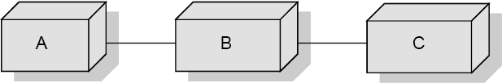
Software Metrics
The Sharing of Data Among Modules
A program normally contains several modules and share coupling among modules. However, it may be desirable to know the amount of data being shared among the modules.
Fig.10: Three modules from an imaginary program

Slide 129
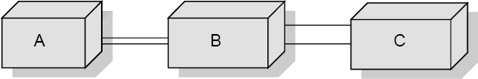
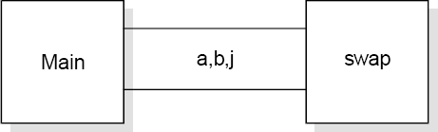
Software Metrics
Fig.11: ”Pipes” of data shared among the modules
Fig.12: The data shared in program bubble

Slide 130
Software Metrics
Information Flow Metrics
Component : Any element identified by decomposing a
(software) system into its constituent parts.
Cohesion : The degree to which a component
performs a single function.
Coupling : The term used to describe the degree of linkage between one component to others in the same system.

Slide 131
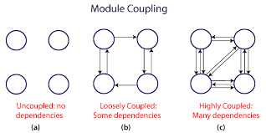
Software Metrics

Slide 132
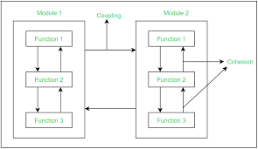
Software Metrics

Slide 133
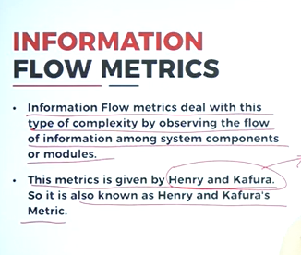
Software Metrics
Information Flow Metrics

Slide 134
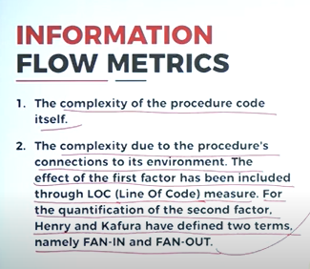
Software Metrics
Information Flow Metrics

Slide 135
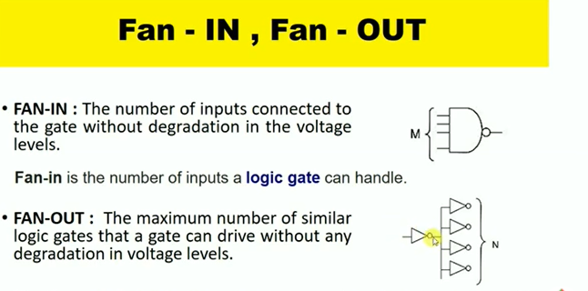
Software Metrics
Information Flow Metrics
Notes:
It was originally the structure of electronic components and their input and output terminals in electronic technology.

Slide 136
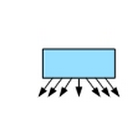
Software Metrics
The Basic Information Flow Model
FANOUT
The number of times a module calls other modules is called the fan-out of the module . The larger the fan-out , the more issues need to be considered when designing the module, and thus the higher the complexity.

Slide 137
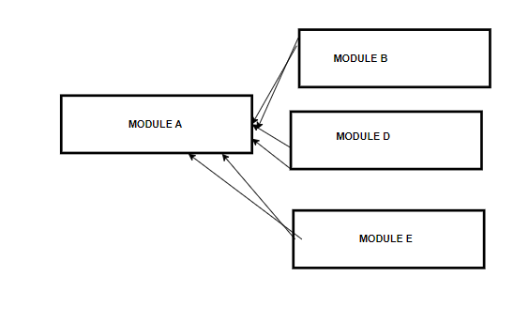
Software Metrics
The Basic Information Flow Model
FANIN
The number of calls of a module by other modules is called the fan-in of the module. A larger fan-in generally does not affect the complexity of the problem, and the larger the fan-in, the better the reusability of the module.
Notes:
In summary, when designing the function, we must design a function with high fan-in and reasonable fan-out

Slide 138
Software Metrics
The Basic Information Flow Model
Information Flow metrics are applied to the Components of a system design. Fig. 13 shows a fragment of such a design, and for component ‘A’ we can define three measures, but remember that these are the simplest models of IF.
‘FAN IN’ is simply a count of the number of other Components that can call, or pass control, to Component A.
‘FANOUT’ is the number of Components that are called by Component A.
This is derived from the first two by using the following formula. We will call this measure the INFORMATION FLOW index of Component A, abbreviated as IF(A).
IF(A) = [FAN IN(A) x FAN OUT (A)]²

Slide 139
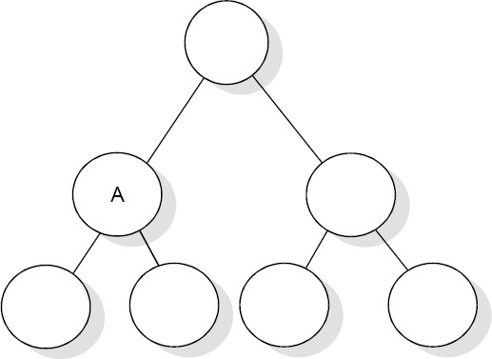
Software Metrics
Fig.13: Aspects of complexity

Slide 140
Software Metrics
The following is a step-by-step guide to deriving these most simple of IF metrics.
Note the level of each Component in the system design.
For each Component, count the number of calls so that Component – this is the FAN IN of that Component. Some organizations allow more than one Component at the highest level in the design, so for Components at the highest level which should have a FAN IN of zero, assign a FAN IN of one. Also note that a simple model of FAN IN can penalize reused Components.
For each Component, count the number of calls from the Component. For Component that call no other, assign a FAN OUT value of one.
cont…

Slide 141
Software Metrics
Calculate the IF value for each Component using the above formula.
Sum the IF value for all Components within each level which is called as the LEVEL SUM.
Sum the IF values for the total system design which is called the SYSTEM SUM.
For each level, rank the Component in that level according to FAN IN, FAN OUT and IF values. Three histograms or line plots should be prepared for each level.
Plot the LEVEL SUM values for each level using a histogram or line plot.

Slide 142
Software Metrics
A More Sophisticated Information Flow Model
a = the number of components that call A.
b = the number of parameters passed to A from components higher in the hierarchy.
c = the number of parameters passed to A from components lower in the hierarchy.
d = the number of data elements read by component A.
Then:
FAN IN(A)= a + b + c + d

Slide 143
Software Metrics
Also let:
e = the number of components called by A;
f = the number of parameters passed from A to components in the hierarchy;
higher
g = the number of parameters passed from A to components lower in the hierarchy;
h = the number of data elements written to by A.
Then:
FAN OUT(A)= e + f + g + h

Slide 144
Software Metrics
S. No | Topic
1. | LOC, Token Count, Function Count
2 | Design Metrics
3 | Data Structure Metrics
4 | Information Flow Metric
5 | Cost estimation, static, Single and multivariate models, COCOMO model,
6 | Putnam Resource Allocation Model
7 | Risk management

Slide 145
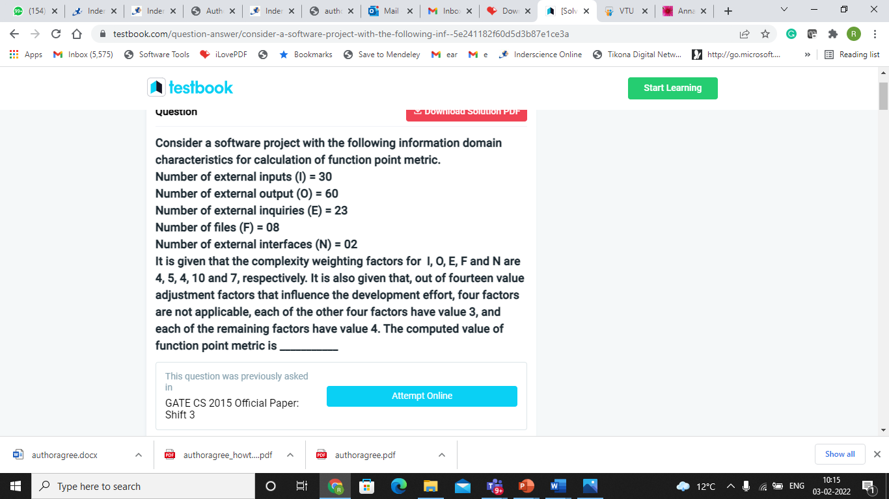
Numerical on function point

Slide 146
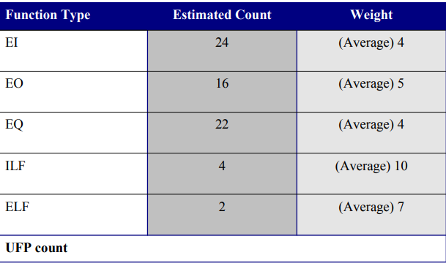
Numerical on function point

Slide 147
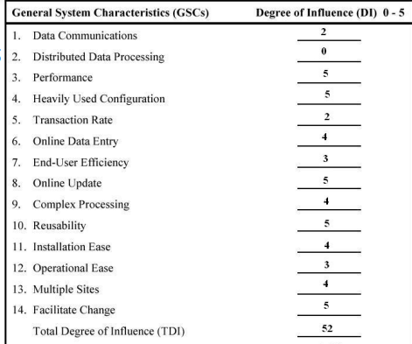
Numerical on function point

Slide 148
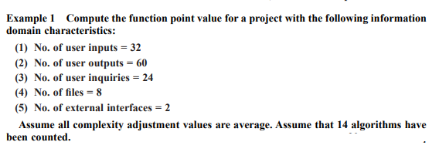
Numerical on function point

Slide 149
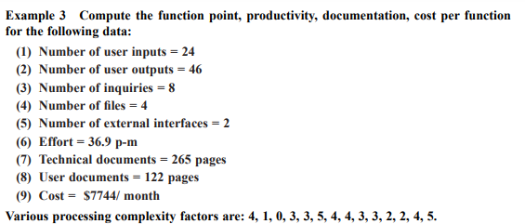
Numerical on function point

Slide 150

Numerical on function point

Slide 151
COCOMO: Concept
Cocomo (Constructive Cost Model) is a regression model based on LOC, i.e. number of Lines of Code. It is a procedural cost estimate model for software projects and often used as a process of reliably predicting the various parameters associated with making a project such as size, effort, cost, time and quality. It was proposed by Barry Boehm in 1970 and is based on the study of 63 projects, which make it one of the best-documented models.

Slide 152
Software Metrics
S. No | Topic
1. | LOC, Token Count, Function Count
2 | Design Metrics
3 | Data Structure Metrics
4 | Information Flow Metric
5 | Cost estimation, static, Single and multivariate models, COCOMO model,
6 | Putnam Resource Allocation Model
7 | Risk management

Slide 153

COCOMO: Concept

Slide 154

COCOMO: Concept

Slide 155

COCOMO: Concept

Slide 156

COCOMO: Concept

Slide 157

COCOMO: Concept

Slide 158

COCOMO: Concept

Slide 159
COCOMO: Concept
The key parameters which define the quality of any software products, which are also an outcome of the Cocomo are primarily Effort & Schedule:
Effort: Amount of labor that will be required to complete a task. It is measured in person-months units.
Schedule: Simply means the amount of time required for the completion of the job, which is, of course, proportional to the effort put. It is measured in the units of time such as weeks, months.

Slide 160

COCOMO: Types
Different models of Cocomo have been proposed to predict the cost estimation at different levels, based on the amount of accuracy and correctness required. All of these models can be applied to a variety of projects, whose characteristics determine the value of constant to be used in subsequent calculations. These characteristics pertaining to different system types are mentioned here.

Slide 161
COCOMO: Types
Boehm’s definition of organic, semidetached, and embedded systems:
Organic – A software project is said to be an organic type if the team size required is adequately small, the problem is well understood and has been solved in the past and also the team members have a nominal experience regarding the problem.
Semi-detached – A software project is said to be a Semi-detached type if the vital characteristics such as team-size, experience, knowledge of the various programming environment lie in between that of organic and Embedded. The projects classified as Semi-Detached are comparatively less familiar and difficult to develop compared to the organic ones and require more experience and better guidance and creativity. Eg: Compilers or different Embedded Systems can be considered of Semi-Detached type.

Slide 162
COCOMO: Types
Embedded – A software project with requiring the highest level of complexity, creativity, and experience requirement fall under this category. Such software requires a larger team size than the other two models and also the developers need to be sufficiently experienced and creative to develop such complex models.
NOTE: All the above system types utilize different values of the constants used in Effort Calculations.

Slide 163


Slide 164
COCOMO: Types
COCOMO consists of a hierarchy of three increasingly detailed and accurate forms. Any of the three forms can be adopted according to our requirements. These are types of COCOMO model:
Basic COCOMO Model
Intermediate COCOMO Model
Detailed COCOMO Model
The first level, Basic COCOMO can be used for quick and slightly rough calculations of Software Costs. Its accuracy is somewhat restricted due to the absence of sufficient factor considerations.
Intermediate COCOMO takes these Cost Drivers into account and Detailed COCOMO additionally accounts for the influence of individual project phases, i.e. in case of Detailed it accounts for both these cost drivers and also calculations are performed phase wise henceforth producing a more accurate result. These two models are further discussed below.

Slide 165

BASIC COCOMO MODEL
These formula are used for the cost estimation of for the basic COCOMO model, and also is used in the subsequent models. The constant values a, b, c and d for the Basic Model for the different categories of system:
Software Projects | a | b | c | d
Organic | 2.4 | 1.05 | 2.5 | 0.38
Semi Detached | 3.0 | 1.12 | 2.5 | 0.35
Embedded | 3.6 | 1.20 | 2.5 | 0.32

Slide 166
BASIC COCOMO MODEL
The effort is measured in Person-Months and as evident from the formula is dependent on Kilo-Lines of code.
The development time is measured in Months.
These formulas are used as such in the Basic Model calculations, as not much consideration of different factors such as reliability, expertise is taken into account, henceforth the estimate is rough.

Slide 167

BASIC COCOMO MODEL

Slide 168

BASIC COCOMO MODEL

Slide 169
Software Project Planning
Basic Model
Basic COCOMO model takes the form
E = a (KLOC)^{bb}
b
D = c (E)
d
b
b
where E is effort applied in Person-Months, and D is the development time in months. The coefficients a_{b}, b_{b}, c_{b} and d_{b} are given in table 4 (a).
44

Slide 170
Software Project Planning
When effort and development time are known, the average staff size to complete the project may be calculated as:
E
Average staff size (SS ) =
Persons
D
When project size is known, the productivity
level may be
calculated as:
Productivity (P) = ^{KLOC} KLOC / PM
E
46

Slide 171
Software Project Planning
Example: 4.5
Suppose that a project was estimated to be 400 KLOC. Calculate the effort and development time for each of the three modes i.e., organic, semidetached and embedded.
47

Slide 172

Numerical on Cocomo

Slide 173
Software Project Planning
Solution
The basic COCOMO equation take the form:
b_{b}
E = a_{b} (KLOC)
D = c (KLOC)^{db}
b
Estimated size of the project = 400 KLOC
(i) Organic mode
E = 2.4(400)^{1.05} = 1295.31 PM
D = 2.5(1295.31)^{0.38} = 38.07 PM
48

Slide 174
Software Project Planning
Semidetached mode
E = 3.0(400)^{1.12} = 2462.79 PM
D = 2.5(2462.79)^{0.35} = 38.45 PM
Embedded mode
E = 3.6(400)^{1.20} = 4772.81 PM
D = 2.5(4772.8)^{0.32} = 38 PM
49

Slide 175
Software Project Planning
Example: 4.6
A project size
of 200 KLOC is to be developed. Software
development team has average experience on similar type of projects. The project schedule is not very tight. Calculate the effort, development time, average staff size and productivity of the project.
50

Slide 176
Software Project Planning
Solution
The semi-detached mode is the most appropriate mode; keeping in view the size, schedule and experience of the development team.
E = 3.0(200)^{1.12} = 1133.12 PM
D = 2.5(1133.12)^{0.35} = 29.3 PM
Hence
E
Average staff size (SS ) =
Persons
D
= ^{1133.12} = 38.67Persons
29.3
51

Slide 177
Software Project Planning
KLOC
200
Productivity
=
=
= 0.1765 KLOC / PM
E 1133.12
P = 176 LOC / PM
52

Slide 178
Software Project Planning
Solve own your own
A project size
of 800 KLOC is to be developed.
Calculate the effort, development time, average staff size and productivity of the project.
50

Slide 179
INTERMEDIATE COCOMO MODEL
The basic Cocomo model assumes that the effort is only a function of the number of lines of code and some constants evaluated according to the different software system. However, in reality, no system’s effort and schedule can be solely calculated on the basis of Lines of Code. For that, various other factors such as reliability, experience, Capability. These factors are known as Cost Drivers and the Intermediate Model utilizes 15 such drivers for cost estimation.

Slide 180
INTERMEDIATE COCOMO MODEL
Classification of Cost Drivers and their attributes
Product attributes –
Required software reliability extent
Size of the application database
The complexity of the product
Hardware attributes –
Run-time performance constraints
Memory constraints
The volatility of the virtual machine environment
Required turnabout time
Personnel attributes –
Analyst capability
Software engineering capability
Applications experience
Virtual machine experience
Programming language experience
Project attributes –
Use of software tools
Application of software engineering methods
Required development schedule

Slide 181

INTERMEDIATE COCOMO MODEL
The project manager is to rate these 15 different parameters for a particular project on a scale of one to three. Then, depending on these ratings, appropriate cost driver values are taken from the above table. These 15 values are then multiplied to calculate the EAF (Effort Adjustment Factor). The Intermediate COCOMO formula now takes the form:
The values of a and b in case of the intermediate model are as follows:
Software Projects | a | b
Organic | 3.2 | 1.05
Semi Detached | 3.0 | 1.12
Embedded | 2.8 | 1.20

Slide 182
Software Project Planning
Multipliers of different cost drivers
Cost Drivers | RATINGS
 | Very low | Low | Nominal | High | Very high | Extra high
Product Attributes
RELY | 0.75 | 0.88 | 1.00 | 1.15 | 1.40 | --
DATA | -- | 0.94 | 1.00 | 1.08 | 1.16 | --
CPLX | 0.70 | 0.85 | 1.00 | 1.15 | 1.30 | 1.65
Computer Attributes
TIME | -- | -- | 1.00 | 1.11 | 1.30 | 1.66
STOR | -- | -- | 1.00 | 1.06 | 1.21 | 1.56
VIRT | -- | 0.87 | 1.00 | 1.15 | 1.30 | --
TURN | -- | 0.87 | 1.00 | 1.07 | 1.15 | --
55

Slide 183
Software Project Planning
Cost Drivers | RATINGS
 | Very low | Low | Nominal | High | Very high | Extra high
Personnel Attributes
ACAP | 1.46 | 1.19 | 1.00 | 0.86 | 0.71 | --
AEXP | 1.29 | 1.13 | 1.00 | 0.91 | 0.82 | --
PCAP | 1.42 | 1.17 | 1.00 | 0.86 | 0.70 | --
VEXP | 1.21 | 1.10 | 1.00 | 0.90 | -- | --
LEXP | 1.14 | 1.07 | 1.00 | 0.95 | -- | --
Project Attributes
MODP | 1.24 | 1.10 | 1.00 | 0.91 | 0.82 | --
TOOL | 1.24 | 1.10 | 1.00 | 0.91 | 0.83 | --
SCED | 1.23 | 1.08 | 1.00 | 1.04 | 1.10 | --
Table 5: Multiplier values for effort calculations
56

Slide 184
Software Project Planning
Intermediate COCOMO equations
E = a (KLOC)^{bi} * EAF
i
D = c (E)^{di}
i
Project | a_{i} | b_{i} | c_{i} | d_{i}
Organic | 3.2 | 1.05 | 2.5 | 0.38
Semidetached | 3.0 | 1.12 | 2.5 | 0.35
Embedded | 2.8 | 1.20 | 2.5 | 0.32
Table 6: Coefficients for intermediate COCOMO
57

Slide 185

Software Project Planning
Table 6: Coefficients for intermediate COCOMO
57

Slide 186
Software Project Planning
Example: 4.7
A new project with estimated 400 KLOC embedded system has to be developed. Project manager has a choice of hiring from two pools of
developers: Very highly capable with very little experience in the
programming language being used Or
Developers of low quality but a lot of experience with the programming language. What is the impact of hiring all developers from one or the other pool ?
65

Slide 187
Software Project Planning
Solution
This is the COCOMO.
Hence
case of embedded mode and model is intermediate
E = a (KLOC)^{di}
i
= 2.8 (400)^{1.20} = 3712 PM
Case I: Developers are very highly capable with very little experience in the programming being used.
EAF = 0.82 x 1.14 = 0.9348
E = 3712 x .9348 = 3470 PM
D = 2.5 (3470)^{0.32} = 33.9 M
66

Slide 188
Software Project Planning
Case II: Developers are of low quality but lot of experience with the programming language being used.
EAF = 1.29 x 0.95 = 1.22
E = 3712 x 1.22 = 4528 PM
D = 2.5 (4528)^{0.32} = 36.9 M
Case II requires more effort and time. Hence, low quality developers with lot of programming language experience could not match with the performance of very highly capable developers with very litter experience.
67

Slide 189
Software Project Planning
Example: 4.8
Consider a project to develop a full screen editor. The major components identified are:
Screen edit
Command Language Interpreter
File Input & Output
Cursor Movement
Screen Movement
The size of these are estimated to be 4k, 2k, 1k, 2k and 3k delivered source code lines. Use COCOMO to determine
Overall cost and schedule estimates (assume values for different cost drivers, with at least three of them being different from 1.0)
Cost & Schedule estimates for different phases.
68

Slide 190
Software Project Planning
Solution
Size of five modules are:
Screen edit
Command language interpreter File input and output
Cursor movement Screen movement
Total
= 4 KLOC
= 2 KLOC
= 1 KLOC
= 2 KLOC
= 3 KLOC
= 12 KLOC
69

Slide 191
Software Project Planning
Let us assume that significant cost drivers are
Required software reliability is high, i.e.,1.15
Product complexity is high, i.e.,1.15
Analyst capability is high, i.e.,0.86
Programming language experience is low,i.e.,1.07
All other drivers are nominal
EAF = 1.15x1.15x0.86x1.07 = 1.2169
70

Slide 192
Software Project Planning
(a) The initial effort estimate for the project is obtained from the following equation
E = a_{i} (KLOC)^{bi} x EAF
= 3.2(12)^{1.05} x 1.2169 = 52.91 PM
D = C_{i}(E)^{di}
= 2.5(52.91)^{0.38} = 11.29 M
Development time
(b) Using the following equations and referring Table 7, phase wise cost and schedule estimates can be calculated.
E_{p} = μ_{p} E
D_{p} = τ _{p} D
71

Slide 193
Software Project Planning
Since size is only 12 KLOC, it is an organic small model. Phase wise effort distribution is given below:
System Design Detailed Design Module Code & Test Integration & Test
= 0.16 x 52.91 = 8.465 PM
= 0.26 x 52.91 = 13.756 PM
= 0.42 x 52.91 = 22.222 PM
= 0.16 x 52.91 = 8.465 Pm
Now Phase wise development time duration is
System Design Detailed Design Module Code & Test Integration & Test
= 0.19 x 11.29 = 2.145 M
= 0.24 x 11.29 = 2.709 M
= 0.39 x 11.29 = 4.403 M
= 0.18 x 11.29 = 2.032 M
72

Slide 194
Software Project Planning
Solution
Size of five modules are:
Screen edit
Command language interpreter File input and output
Cursor movement Screen movement
Total
= 4 KLOC
= 2 KLOC
= 1 KLOC
= 2 KLOC
= 3 KLOC
= 12 KLOC
69

Slide 195
Software Project Planning
Let us assume that significant cost drivers are
Required software reliability is high, i.e.,1.15
Product complexity is high, i.e.,1.15
Analyst capability is high, i.e.,0.86
Programming language experience is low,i.e.,1.07
All other drivers are nominal
EAF = 1.15x1.15x0.86x1.07 = 1.2169
70

Slide 196
Software Project Planning
(a) The initial effort estimate for the project is obtained from the following equation
E = a_{i} (KLOC)^{bi} x EAF
= 3.2(12)^{1.05} x 1.2169 = 52.91 PM
D = C_{i}(E)^{di}
= 2.5(52.91)^{0.38} = 11.29 M
Development time
71

Slide 197

Software Project Planning

Slide 198
Software Project Planning
Assume that the size of an organic type software product has been estimated to be 32,000 lines of source code. Assume that the average salary of software engineers be Rs. 15,000/- per month. Determine the effort required to develop the software product and the nominal development time.
Example: For a given project was estimated with a size of 300 KLOC. Calculate the Effort, Scheduled time for development by considering developer having high application experience and very low experience in programming.

Slide 199
DETAILED COCOMO MODEL
Detailed COCOMO incorporates all characteristics of the intermediate version with an assessment of the cost driver’s impact on each step of the software engineering process. The detailed model uses different effort multipliers for each cost driver attribute. In detailed COCOMO, the whole software is divided into different modules and then we apply COCOMO in different modules to estimate effort and then sum the effort.

Slide 200
DETAILED COCOMO MODEL
The Six phases of detailed COCOMO are:
Planning and requirements
System design
Detailed design
Module code and test
Integration and test
Cost Constructive model
The effort is calculated as a function of program size and a set of cost drivers are given according to each phase of the software lifecycle.

Slide 201
Software Metrics
S. No | Topic
1. | LOC, Token Count, Function Count
2 | Design Metrics
3 | Data Structure Metrics
4 | Information Flow Metric
5 | Cost estimation, static, Single and multivariate models, COCOMO model,
6 | Putnam Resource Allocation Model
7 | Risk management

Slide 202












Software Project Planning
Putnam Resource Allocation Model
Norden of IBM
Rayleigh curve
Model for a range of hardware development projects.
Overall Curve Design and Coding
Persons
Time
Fig.6: The Rayleigh manpower loading curve
123
Notes:
Mait is

Slide 203
Software Project Planning
Putnam observed that this curve was a close approximation at project level and software subsystem level.
No. of projects = 150
124

Slide 204
Software Project Planning
The Norden / Rayleigh Curve
The curve is modeled by differential equation
m(t) = ^{dy} = 2kate^{−at 2}
--------- (1)
dt
dy
_{dt} = manpower utilization rate per unit time
a = parameter that affects the shape of the curve K = area under curve in the interval [0, ∞ ]
t = elapsed time
125

Slide 205
Software Project Planning
On Integration on interval [o, t]
y(t) = K [1-e^{-at2}] -------------(2)
Where y(t): cumulative manpower used upto time t.
y(0) = 0
y(∞) = k
The cumulative manpower is null at the start of the project, and grows monotonically towards the total effort K (area under the curve).
126

Slide 206

Software Project Planning

Slide 207
Software Project Planning
1
Replace “a” with
in the Norden/Rayleigh model. By
2t ²
d
making this substitution in equation we have
_{t} 2
2K
−
m(t) =
te
2t ²
d
2t ²
d
_{t} 2
K
−
=
te
2t
2
d
_{t} 2
d
128

Slide 208
Software Project Planning
a=2
a=0.5
a=0.222
m (t) Person
a=0.125
Time (years)
Fig.7: Influence of parameter ‘a’ on the manpower
distribution
129

Slide 209
Software Project Planning
At time t=t_{d}, peak manning m (t_{d}) is obtained and denoted by m_{o}.
k
m =
o
t_{d} e
k t_{d} m₀ e
= Total project cost/effort in person-years.
= Delivery time in years
= No. of persons employed at the peak
= 2.71828
130

Slide 210
Software Project Planning
Example: 4.12
A software development project is planned to cost 95 MY in a period of 1 year and 9 months. Calculate the peak manning and average rate of software team build up.
131

Slide 211
Software Project Planning
Solution
Software development cost Peak development time
k=95 MY
t_{d} = 1.75 years
k
Peak manning
m_{o}=
t e
d
95
= 32.94 = 33 persons
1.75×1.648
Average rate of software team build up
m₀
= =
33
= 18.8 persons / year or 1.56 person / month
t_{d} 1.75
132

Slide 212
Software Project Planning
Example: 4.13
Consider a large-scale project for which the manpower requirement is K=600 PY and the development time is 3 years 6 months.
Calculate the peak manning and peak time.
What is the manpower cost after 1 year and 2 months?
133

Slide 213
Software Project Planning
Solution
(a) We know t_{d}=3 years and 6 months = 3.5 years
₌ K t_{d} e
NOW
m
0
∴ m₀ =
600/(3.5x1.648) ≅ 104 persons
134

Slide 214
y(t) = K [1− e^{−at 2} ]
Software Project Planning
(b) We know
t = 1 year and 2 months
= 1.17 years
1 1
a =
= = 0.041
2t ²
2 × (3.5)²
d
y (1.17 ) = 600 [1 − e ^{− 0.041 (1.17 ) 2} ]
= 32.6 PY
135

Slide 215
Software Project Planning
Difficulty Metric
Slope of manpower distribution curve at start time t=0 has some useful properties.
2
d y
m'(t) = = 2kae
−at
2
2
(1− 2at )
dt ²
Then, for t=0
m'(0) = 2Ka = ^{2K} = ^{K}
2t ²
_{t} 2
d
d
136

Slide 216
Software Project Planning
K
The ratio is called difficulty and denoted by D,
_{t} 2
d
which is measured in person/year :
k
D=
_{t}2
persons/year
d
137

Slide 217
Software Project Planning
Project is difficult to develop if
Manpower demand is high
When time schedule is short
138

Slide 218
Software Project Planning
Peak manning is defined as:
k
m =
0
t_{d} e
e
D = ^{k} = ^{m0}
_{t} 2
t
d d
Thus difficult projects tend to have a higher peak manning for a given development time, which is in line with Norden’s observations relative to the parameter “a”.
139

Slide 219
Software Project Planning
Manpower buildup
D is dependent upon “K”. The derivative of D relative to “K” and “t_{d}” are
D'(t ) = ^{−2k} persons / year ²
d
_{t} 3
d
D'(k) = ¹ year ⁻²
_{t} 2
d
140

Slide 220
Software Project Planning
D¹(K) will always be very much smaller than the absolute value of D¹(t_{d}). This difference in sensitivity is shown by considering two projects
Project A Project B
: Cost = 20 PY & t_{d} = 1 year
: Cost = 120 PY & t_{d} = 2.5 years
The derivative values are
Project A Project B
: D` (t_{d}) = -40 & D`(K) = 1
: D` (t_{d}) = -15.36 & D`(K) = 0.16
This shows that a given software development is time sensitive.
141

Slide 221
Software Project Planning
Putnam observed that
Difficulty derivative relative to time
Behavior of s/w development
If project scale is increased, the development time also
increase to such an extent that
k
remains constant
_{t} 3
d
around a value which could be 8,15,27.
142

Slide 222
Software Project Planning
It is represented by D₀ and can be expressed as:
D = ^{k} person / year ²
0
_{t} 3
d
D₀ =8, new s/w with many interfaces & interactions with other systems.
D₀ =15, New standalone system.
D₀ =27, The software is rebuild form existing software.
143

Slide 223
Software Project Planning
Example: 4.14
Consider the example 4.13 and calculate the difficulty and manpower build up.
144

Slide 224
Software Project Planning
Solution
We know
D = ^{K}
Difficulty
_{t} 2
d
600
=
= 49 person / year
(3.5)²
Manpower build up can be calculated by following equation
D = ^{K}
0
_{t} 3
d
600
=
= 14 person / year ²
(3.5)³
145

Slide 225
Software Metrics
S. No | Topic
1. | LOC, Token Count, Function Count
2 | Design Metrics
3 | Data Structure Metrics
4 | Information Flow Metric
5 | Cost estimation, static, Single and multivariate models, COCOMO model,
6 | Putnam Resource Allocation Model
7 | Risk management

Slide 226
Software Project Planning
Software Risk Management
We Software developers are extremely optimists.
We assume, everything will go exactly as planned.
Other view
not possible to predict what is going to happen ?
Software surprises Never good news
180

Slide 227
Software Project Planning
Risk factor
management is required to reduce this surprise
Dealing with concern before it becomes a crisis.
Quantify probability of failure & consequences of failure.
181

Slide 228
Software Project Planning
What is risk ?
Tomorrow’s problems are today’s risks.
“Risk is a problem that may cause some loss or threaten the success of the project, but which has not happened yet”.
182

Slide 229
Software Project Planning
Risk management is the process of identifying addressing and eliminating these problems before they can damage the project.
Current problems &
Potential Problems
183

Slide 230
Software Project Planning
Typical Software Risk
Capers Jones has identified the top five risk factors that threaten projects in different applications.
Dependencies on outside agencies or factors.
Availability of trained, experienced persons
Inter group dependencies
Customer-Furnished items or information
Internal & external subcontractor relationships
184

Slide 231
Software Project Planning
2.
Requirement issues
Uncertain requirements
Wrong product
or
Right product badly
Either situation results in unpleasant unhappy customers.
surprises and
185

Slide 232
Software Project Planning
Lack of clear product vision
Lack of agreement on product requirements
Unprioritized requirements
New market with uncertain needs
Rapidly changing requirements
Inadequate Impact analysis of requirements changes
186

Slide 233
Software Project Planning
3. Management Issues
Project managers plans, and most
usually write the risk management people do not wish to air their
weaknesses in public.
Inadequate planning
Inadequate visibility into actual project status
Unclear project ownership and decision making
Staff personality conflicts
Unrealistic expectation
Poor communication
187

Slide 234
Software Project Planning
4.
Lack of knowledge
Inadequate training
Poor understanding of methods, tools, and techniques
Inadequate application domain experience
New Technologies
Ineffective, poorly processes
documented or neglected
188

Slide 235
Software Project Planning
5.
Other risk categories
Unavailability of adequate testing facilities
Turnover of essential personnel
Unachievable performance requirements
Technical approaches that may not work
189

Slide 236
Software Project Planning
Risk Management Activities
Risk Identification
Risk Assessment
Risk Analysis
Risk Prioritization
Risk Management
Risk Management Planning
Risk Control
Risk Monitoring
Fig. 9: Risk Management Activities
Risk Resolution
190

Slide 237
Software Project Planning
Risk Assessment
Identification of risks
Risk analysis involves examining how project outcomes might change with modification of risk input variables.
Risk prioritization focus for severe risks.
Risk exposure: It is the product of the probability of incurring a loss due to the risk and the potential magnitude of that loss.
191

Slide 238
Software Project Planning
Another way of handling risk is the risk avoidance. Do not do the risky things! We may avoid risks by not undertaking certain projects, or by relying on proven rather than cutting edge technologies.
192

Slide 239
Software Project Planning
Risk Control
Risk Management Planning produces a plan for dealing with each significant risks.
Record decision in the plan.
Risk resolution is the execution of the plans of dealing with each risk.
193

Slide 240

Object Oriented Metrics
Terminologies
S.No | Term | Meaning/purpose
1 | Object | Object is an entity able to save a state (information) and offers a number of operations (behavior) to either examine or affect this state.
2 | Message | A request that an object makes of another object to perform an operation.
3 | Class | A set of objects that share a common structure and common behavior manifested by a set of methods; the set serves as a template from which object can be created.
4 | Method | an operation upon an object, defined as part of the declaration of a class.
5 | Attribute | Defines the structural properties of a class and unique within a class.
6 | Operation | An action performed by or on an object, available to all instances of class, need not be unique.

Slide 241
Object Oriented Metrics
Terminologies
S.No | Term | Meaning/purpose
7 | Instantiation | The process of creating an instance of the object and binding or adding the specific data.
8 | Inheritance | A relationship among classes, where in an object in a class acquires characteristics from one or more other classes.
9 | Cohesion | The degree to which the methods within a class are related to one another.
10 | Coupling | Object A is coupled to object B, if and only if A sends a message to B.

Slide 242
Object Oriented Metrics
Measuring on class level
coupling
inheritance
methods
attributes
cohesion
Measuring on system level

Slide 243
Object Oriented Metrics
Size Metrics:
Number of Methods per Class (NOM)
Number of Attributes per Class (NOA)
Weighted Number Methods in a Class (WMC)
– Methods implemented within a class or complexities of all methods
the sum of the

Slide 244
Object Oriented Metrics
Coupling Metrics:
Response for a Class (RFC )
– Number of methods (internal and external) in a class.
Data Abstraction Coupling(DAC)
- Number of Abstract Data Types in a class.
Coupling between Objects (CBO)
– Number of other classes to which it is coupled.

Slide 245
Object Oriented Metrics
Message Passing Coupling (MPC)
Number of send statements defined in a class.
Coupling Factor (CF)
Ratio of actual number of coupling in the system to the max. possible coupling.

Slide 246
Object Oriented Metrics
Cohesion Metrics:
LCOM: Lack of cohesion in methods
– Consider a class C₁ with n methods M₁, M₂…., M_{n}. Let (I_{j})
= set of all instance variables used by method M_{i}. There are n such sets {I₁},…….{I_{n}}. Let
P ={(I_{i} , I_{j} ) | I_{i} ∩I_{j} = 0}andQ ={((I_{i} , I_{j} ) | I_{i} ∩I_{j} ≠ 0}
If all n{( I1 },........ .(I n)}sets are 0 then P=0
LCOM =| P | - | Q |, if | P | > | Q |
= 0 otherwise

Slide 247
Object Oriented Metrics
Tight Class Cohesion (TCC)
_ Percentage of pairs of public methods of the class with common attribute usage.
Loose Class Cohesion (LCC)
– Same as TCC except that this metric also
consider indirectly connected methods.
Information based Cohesion (ICH)
– Number of invocations of other methods of the same
class, weighted by the number of parameters of the invoked method.

Slide 248
Object Oriented Metrics
Inheritance Metrics:
DIT - Depth of inheritance tree
NOC - Number of children
– only immediate subclasses are counted.

Slide 249
Object Oriented Metrics
Inheritance Metrics:
AIF- Attribute Inheritance Factor
– Ratio of the sum of inherited attributes in all classes of the system to the total number of attributes for all classes.
∑
TC
A (C )
AIF =
i =1
d i
∑
TC
i =1
A_{a}(C _{i} )
A_{a}(C_{i} ) = A_{i}(C_{i} ) + A_{d}(C_{i} )
TC= total number of classes
Ad (Ci) = number of attribute declared in a class Ai (Ci) = number of attribute inherited in a class

Slide 250
Object Oriented Metrics
Inheritance Metrics:
MIF- Method Inheritance Factor
– Ratio of the sum of inherited methods in all classes of the system to the total number of methods for all classes.
∑
TC
Mi(Ci)
MIF =
i =1
∑
TC
i =1
Ma(Ci)
Ma(Ci) = Mi(Ci) + Md(Ci)
TC= total number of classes
Md(Ci)= the number of methods declared in a class
Mi(Ci)= the number of methods inherited in a class
88

Slide 251
Use-Case Oriented Metrics
Counting actors
Type | Description | Factor
Simple | Program interface | 1
Average | Interactive or protocol driven interface | 2
Complex | Graphical interface | 3
Actor weighting factors
Simple actor: represents another system with a defined interface.
Average actor: another system that interacts through a text based interface through a protocol such as TCP/IP.
Complex actor: person interacting through a GUI interface.
The actors weight can be calculated by adding these values together.

Slide 252
Use-Case Oriented Metrics
Counting use cases
Type | Description | Factor
Simple | 3 or fewer transactions | 5
Average | 4 to 7 transactions | 10
Complex | More than 7 transactions | 15
Transaction-based weighting factors
The number of each use case type is counted in the software and then each number is multiplied by a weighting factor as shown in table above.

Slide 253

Web Engineering Project Metrics
Ð Number of static web pages
Ð Number of dynamic web pages Ð Number of internal page links Ð Word count
Ð Web page similarity
Ð Web page search and retrieval
Ð Number of static content objects
Ð Number of dynamic content objects

Slide 254
Metrics Analysis
Statistical Techniques
Summary statistics such as mean, median, max. and min.
Graphical representations such as histograms, pie charts and box plots.
Principal component analysis
Regression and correlation analysis
Reliability models for predicting future reliability.

Slide 255
Metrics Analysis
Problems with metric data:
Normal Distribution
Outliers
Measurement Scale
Multicollinearity

Slide 256
Metrics Analysis
Common pool of data:
The selection of projects should be representative and not all come from a single application domain or development styles.
No single very large project should be allowed to dominate the pool.
For some projects, certain metrics may not have been collected.

Slide 257
Metrics Analysis
Pattern of Successful Applications:
Any metric is better then none.
Automation is essential.
Empiricism is better then theory.
Use multifactor rather then single metrics.
Don’t confuse productivity metrics with complexity metrics.
Let them mature.
Maintain them.
Let them die.

